Slide 1
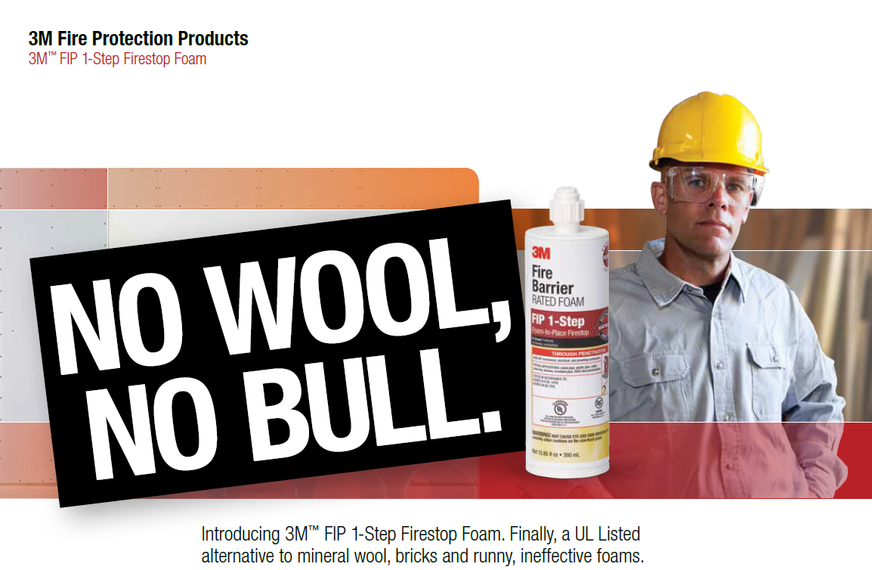
Estimating Information

Slide 2
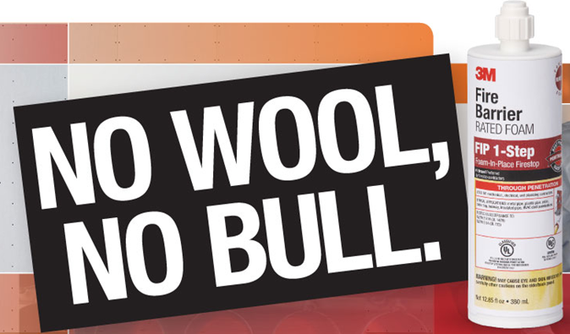
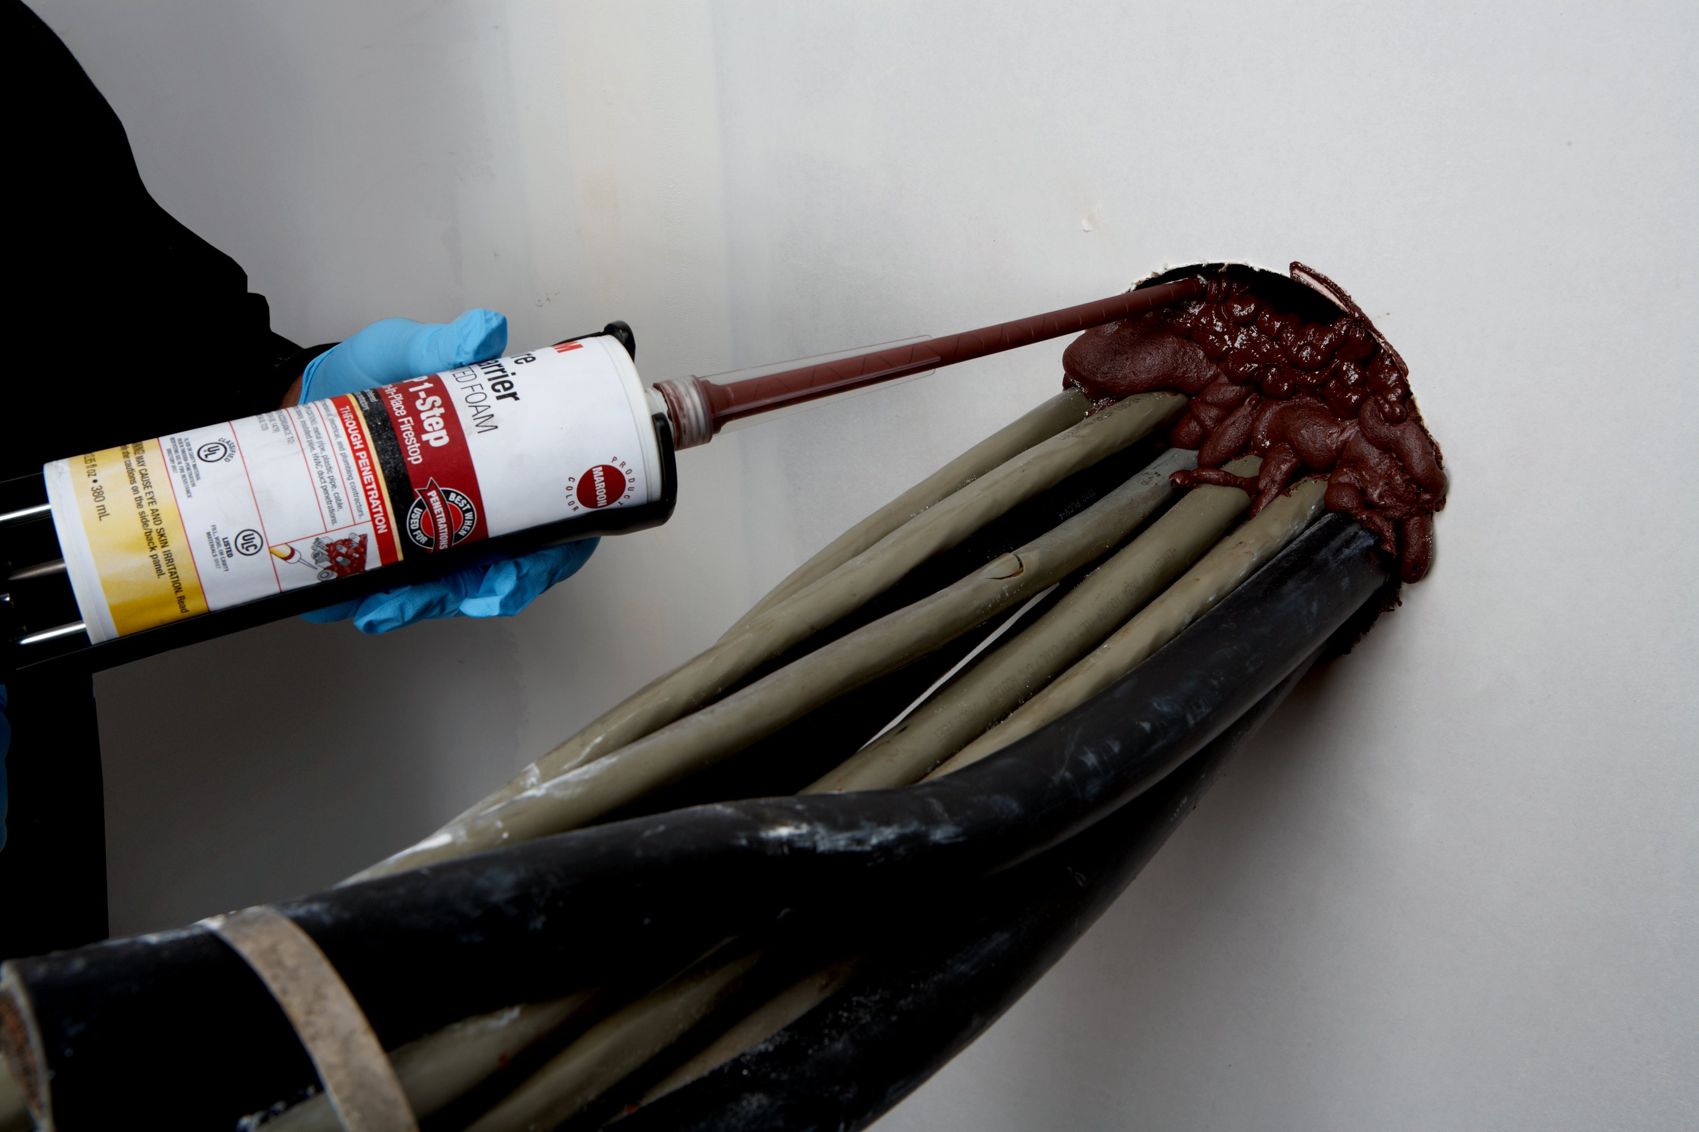
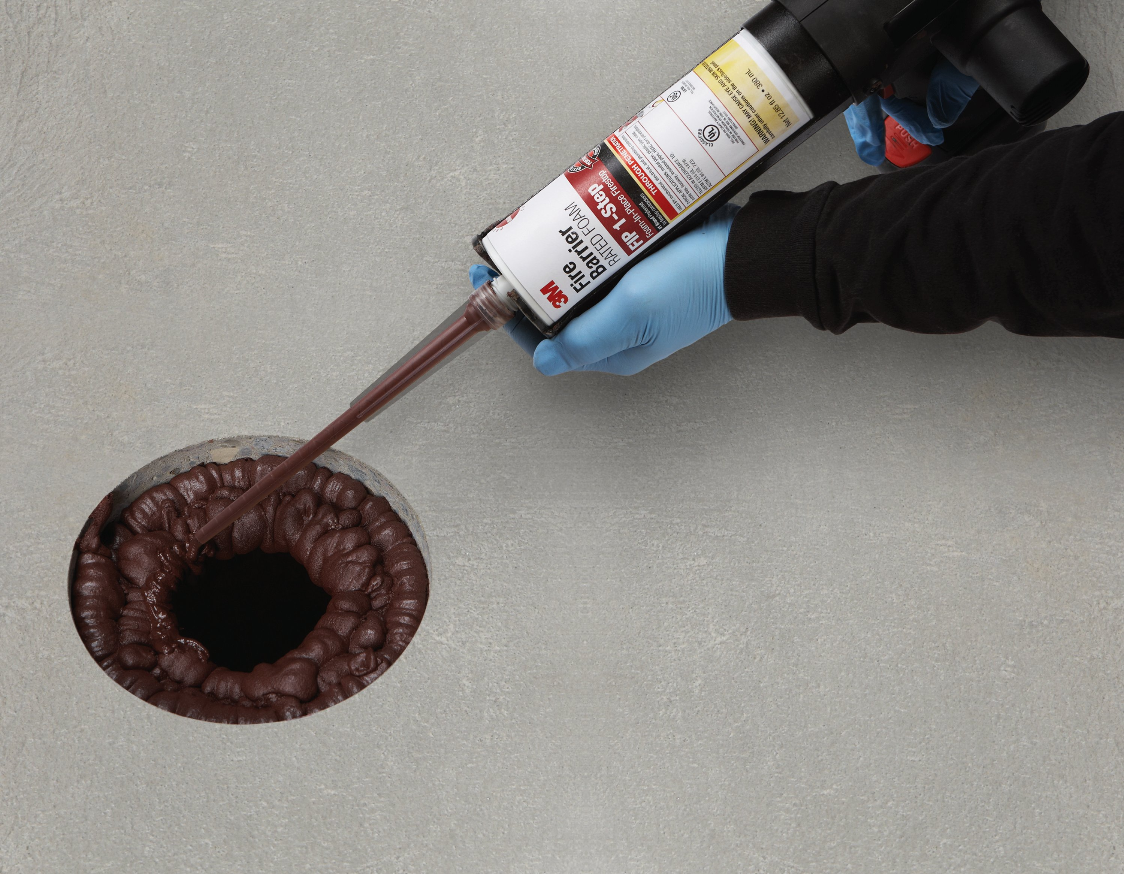
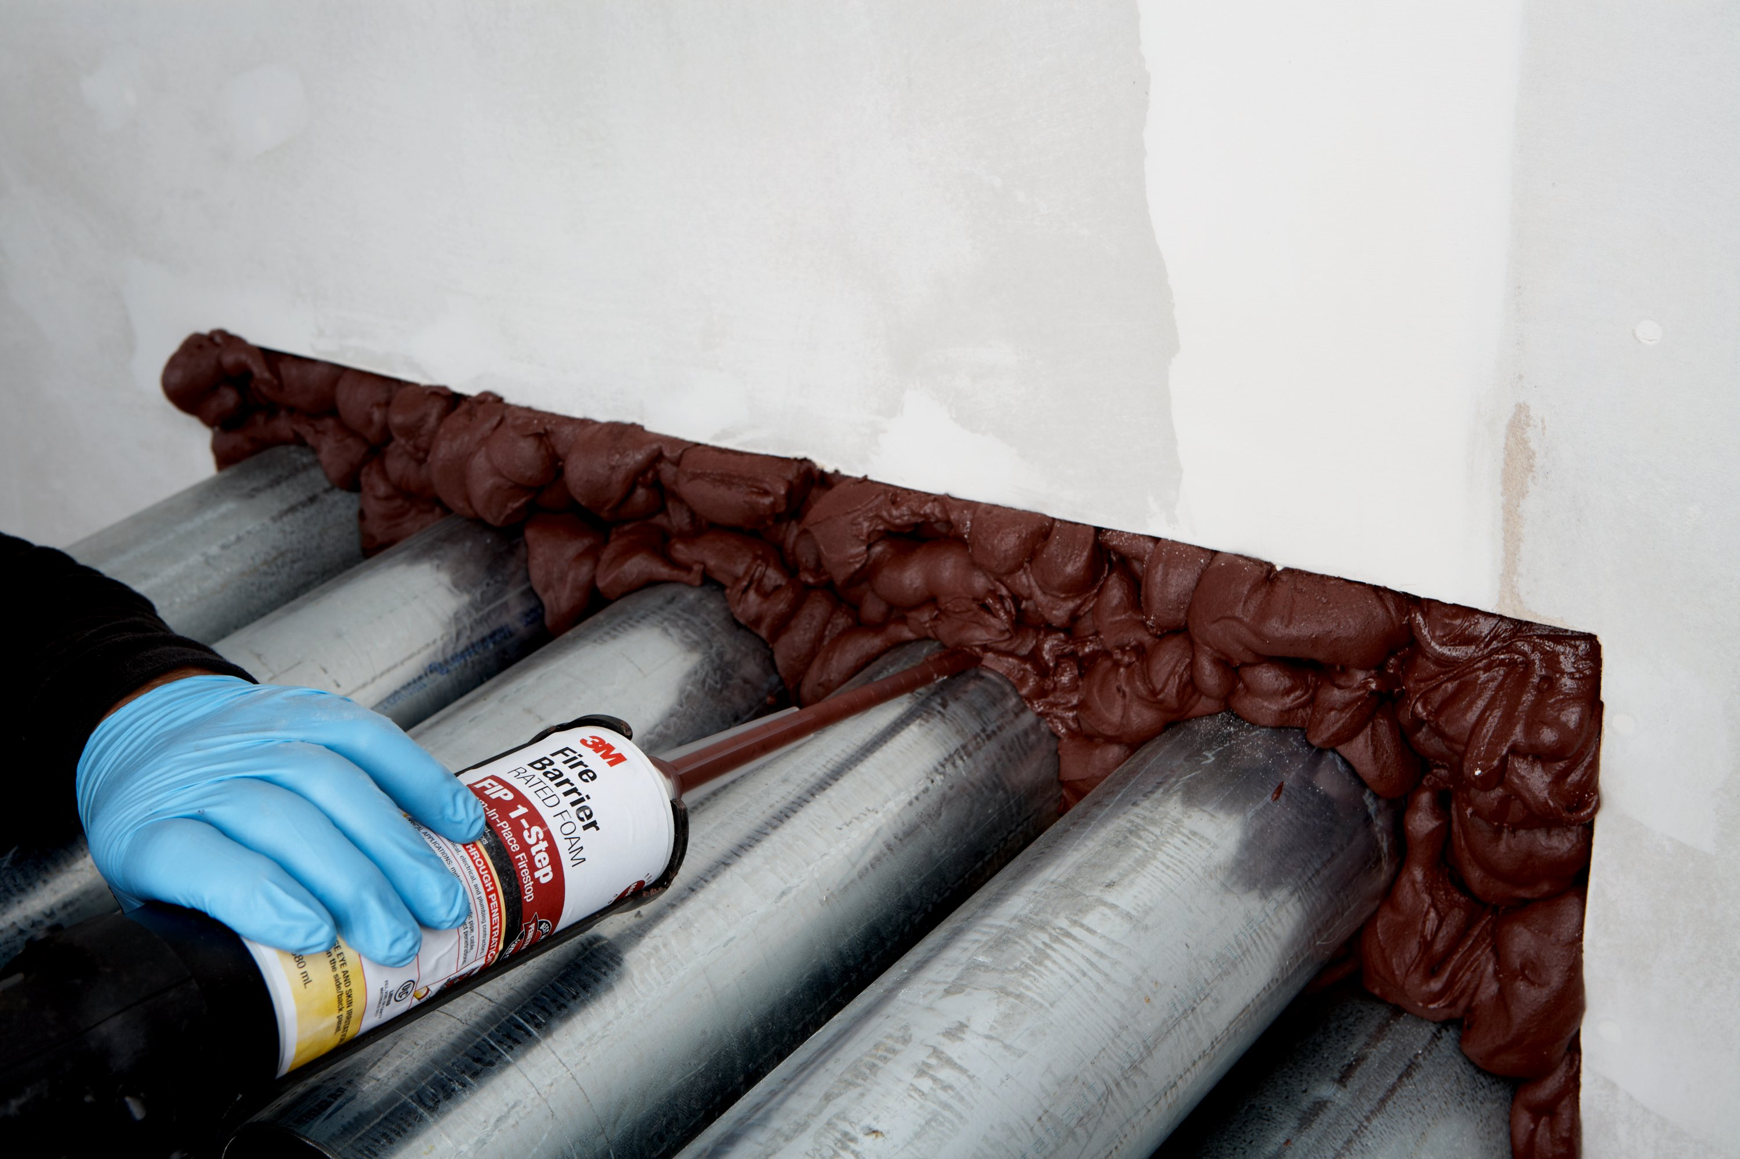
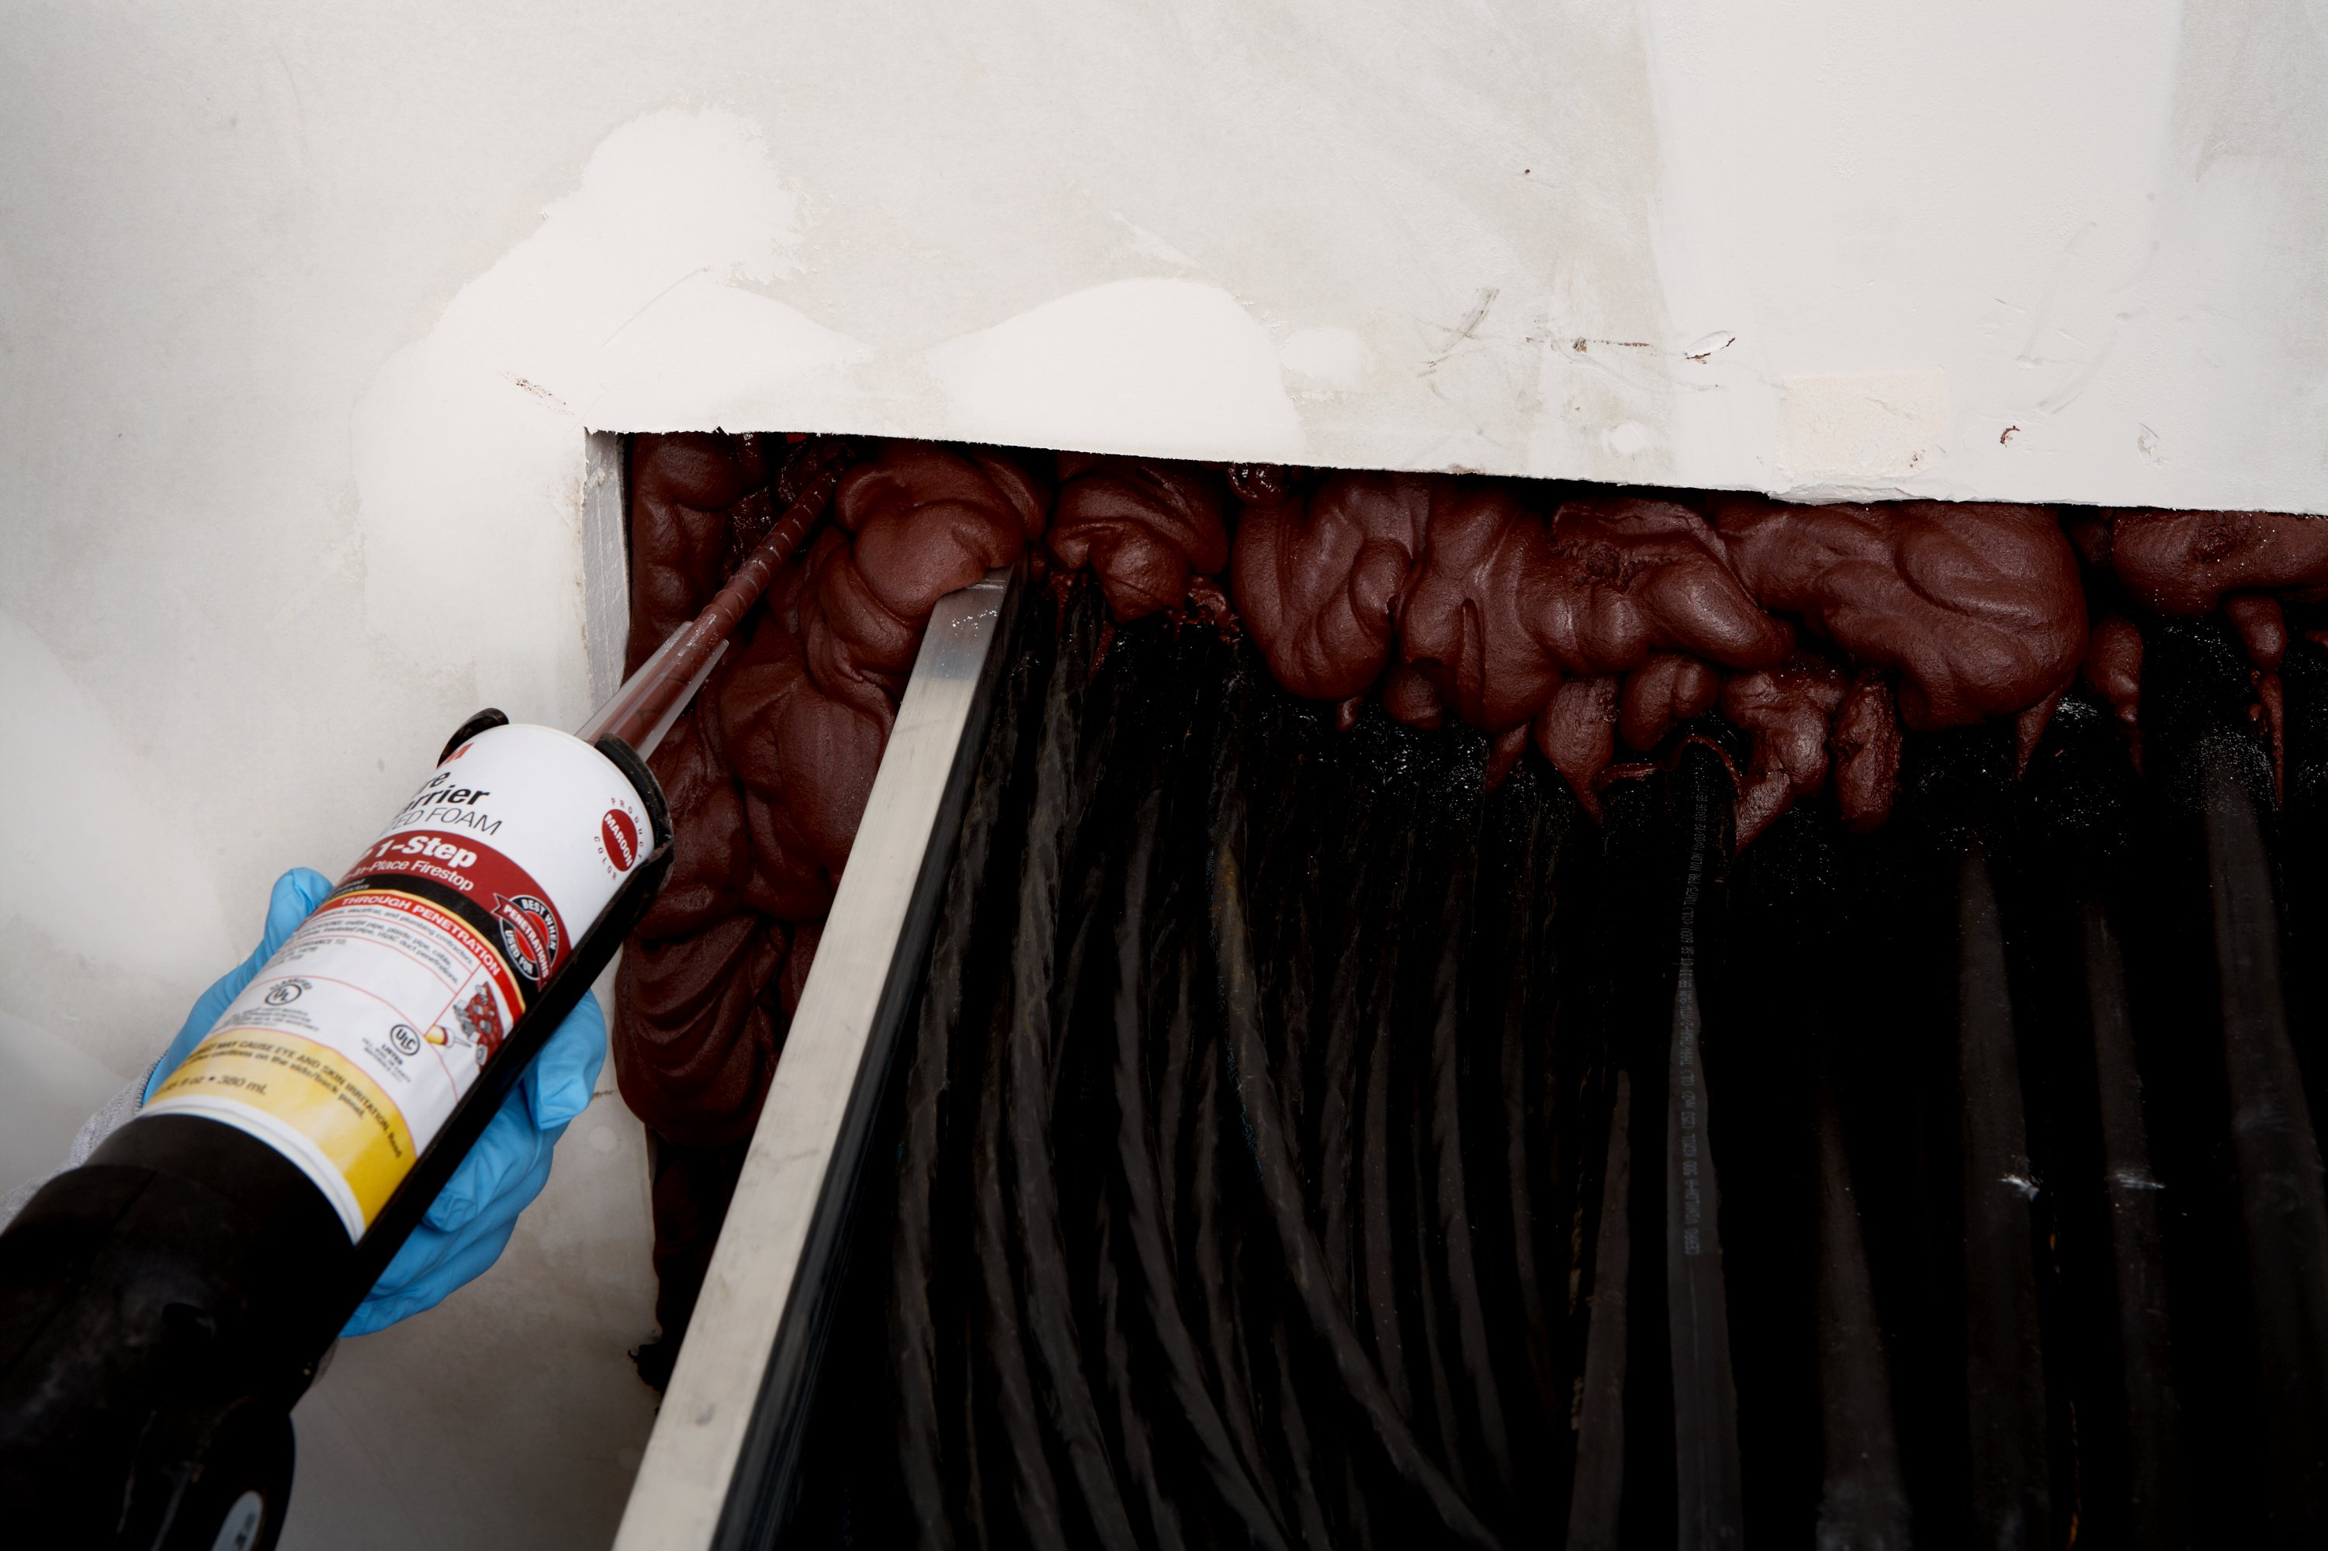
3M™ Fire Barrier Rated Foam
FIP 1-Step
How Much Foam Do I Need?
Facts:
  Cartridge Size:
    Weight 12.85 oz
    Volume 23.19 cu oz
  Up to 5 Times Free Expansion
  One Cartridge Expands up to Approximately 116 Cubic Inches
  One Cartridge Equals over 6 Tubes of 10.1 oz Caulk
  Time Required to Dispense One Cartridge of FIP 1-Step – Approximately 2 Minutes Using an Automatic Dispenser

Slide 3
How Much Foam Do I Need-Typical Examples
Cable Tray
  16” x 8” Opening, (1) 12” x 6” Cable Tray, 2 Hr Gyp Wall (6”)
  Full Depth Foam Requires Approximately 5 FIP 1-Step Cartridges
Blank
  4” Opening, 2.5” Concrete Floor
  Full Depth Foam Requires Approximately 1/3 of 1 FIP 1-Step Cartridge
Conduit Bank
  12” x 6” Opening, (4) 3” Conduit, 2 Hr Gyp Wall (6”)
  Full Depth Foam Requires Approximately 2.5 FIP 1-Step Cartridges
Cable Bundle or Pipe/Conduit
  4” Opening, (1) 3” Cable Bundle, 2 Hr Gyp Wall (6”)
  Full Depth Foam Requires Approximately 1/3 of 1 FIP 1-Step Cartridge

Slide 4
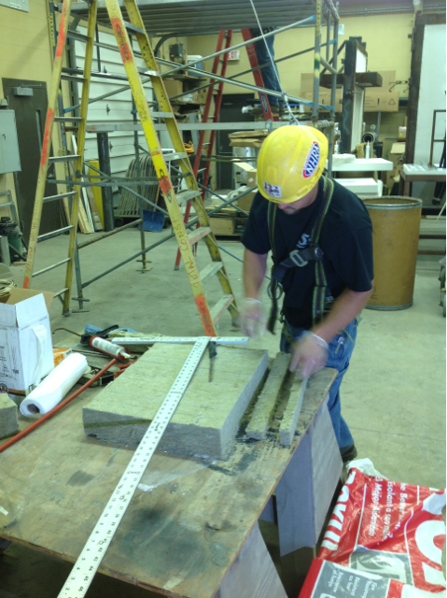
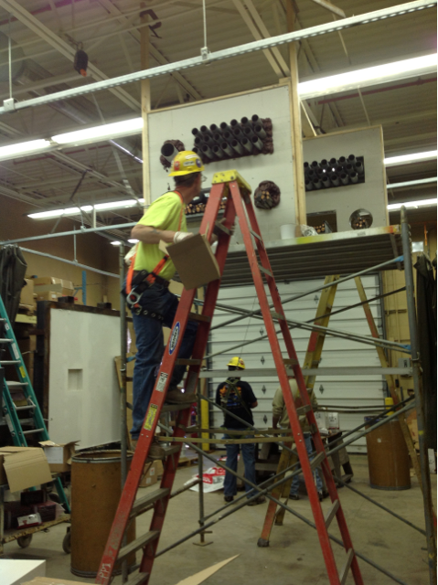
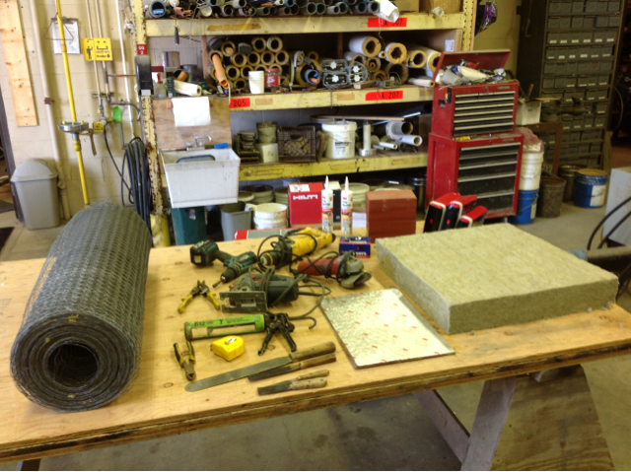
  Additional Considerations When Estimating and Choosing FIP 1-Step
Time required :
  to go to another distributor to purchase mineral wool - Zero
  to install mineral wool - Zero
  to install FIP 1-Step on both sides of wall - Minimal
  to trowel and tool FIP 1-Step – Zero (none required)
  to go up/down ladders and lifts – Minimal compared to taking caulk, mineral wool, pillows, chicken wire, putty etc up the ladder
  to measure amount of caulk required in opening per the UL system – Zero (Fill to full depth of opening)
  to clean excess caulk on floor and clothes – Less mess, less wasted material, less “red stuff” on your clothes

Slide 5

3M™ Fire Barrier Rated Foam
FIP 1-Step Estimating Charts – Rectangular Opening
Double click on red box to enter values

Slide 6
3M™ Fire Barrier Rated Foam
FIP 1-Step Estimating Charts – Circular Opening
Double click on red box to enter values
3M is a trademark of 3M
www.3m.com/firestopfoam

